Slide 1
Pacemaker
Team 7

Slide 2
Project Proposal Checkbox (DUE 9/27 23:59)
TODO | 담당자 | 완료
Target users and the problem they are facing | 재헌 | O
Existing solutions and their limitations | 재헌 | △
The key solution idea to tackle the problem |  | X
Usage scenarios |  | X
The proposed system overview and specific functions | 재헌/ | △
Expected (technical) challenges and solution ideas !! NOVELTY !! |  | X
Evaluation strategy |  | X
Overall project plan (Gantt Chart ?) |  | O
Final deliverable and success criteria |  | X

Slide 3
Introduction
Main problem:
Many users find it difficult to maintain an optimal pace for the duration of a run
Many factors including weather, current health conditions, terrain, etc. contribute to this difficulty
Existing running apps (Nike, Samsung Health, etc.) measure speed after a workout has ended
This leads to poor feedback during the actual exercise.
Many people do not know how long they should exercise for, with many losing motivation after a few weeks
Solution:
Create a pace-keeping application that monitors a user’s running speed and proposes an optimal pace based on micro/macro factors
Macro factors: target weight, target distance, previous time records, etc.
Micro factors: current terrain conditions (asphalt, incline, etc.), heart rate, etc.
Implement a game system to motivate users to reach their goals
Target audience:
Health-aware users who wish to augment their daily exercises with AI assisted jogging/walking routines
Professional runners who wish to closely monitor their running speed and improve their record times
Anyone who wants to lose weight through consistent exercise

Slide 4
Existing Applications
Runkeeper Elite: paid app that keeps track of runner’s speed
Only updates user on running speed every kilometer (not real-time)

Slide 5
Motivation

Slide 6
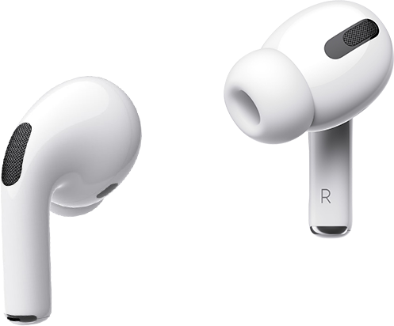
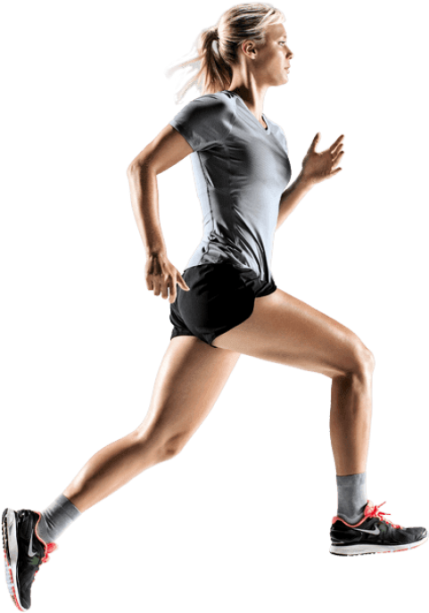
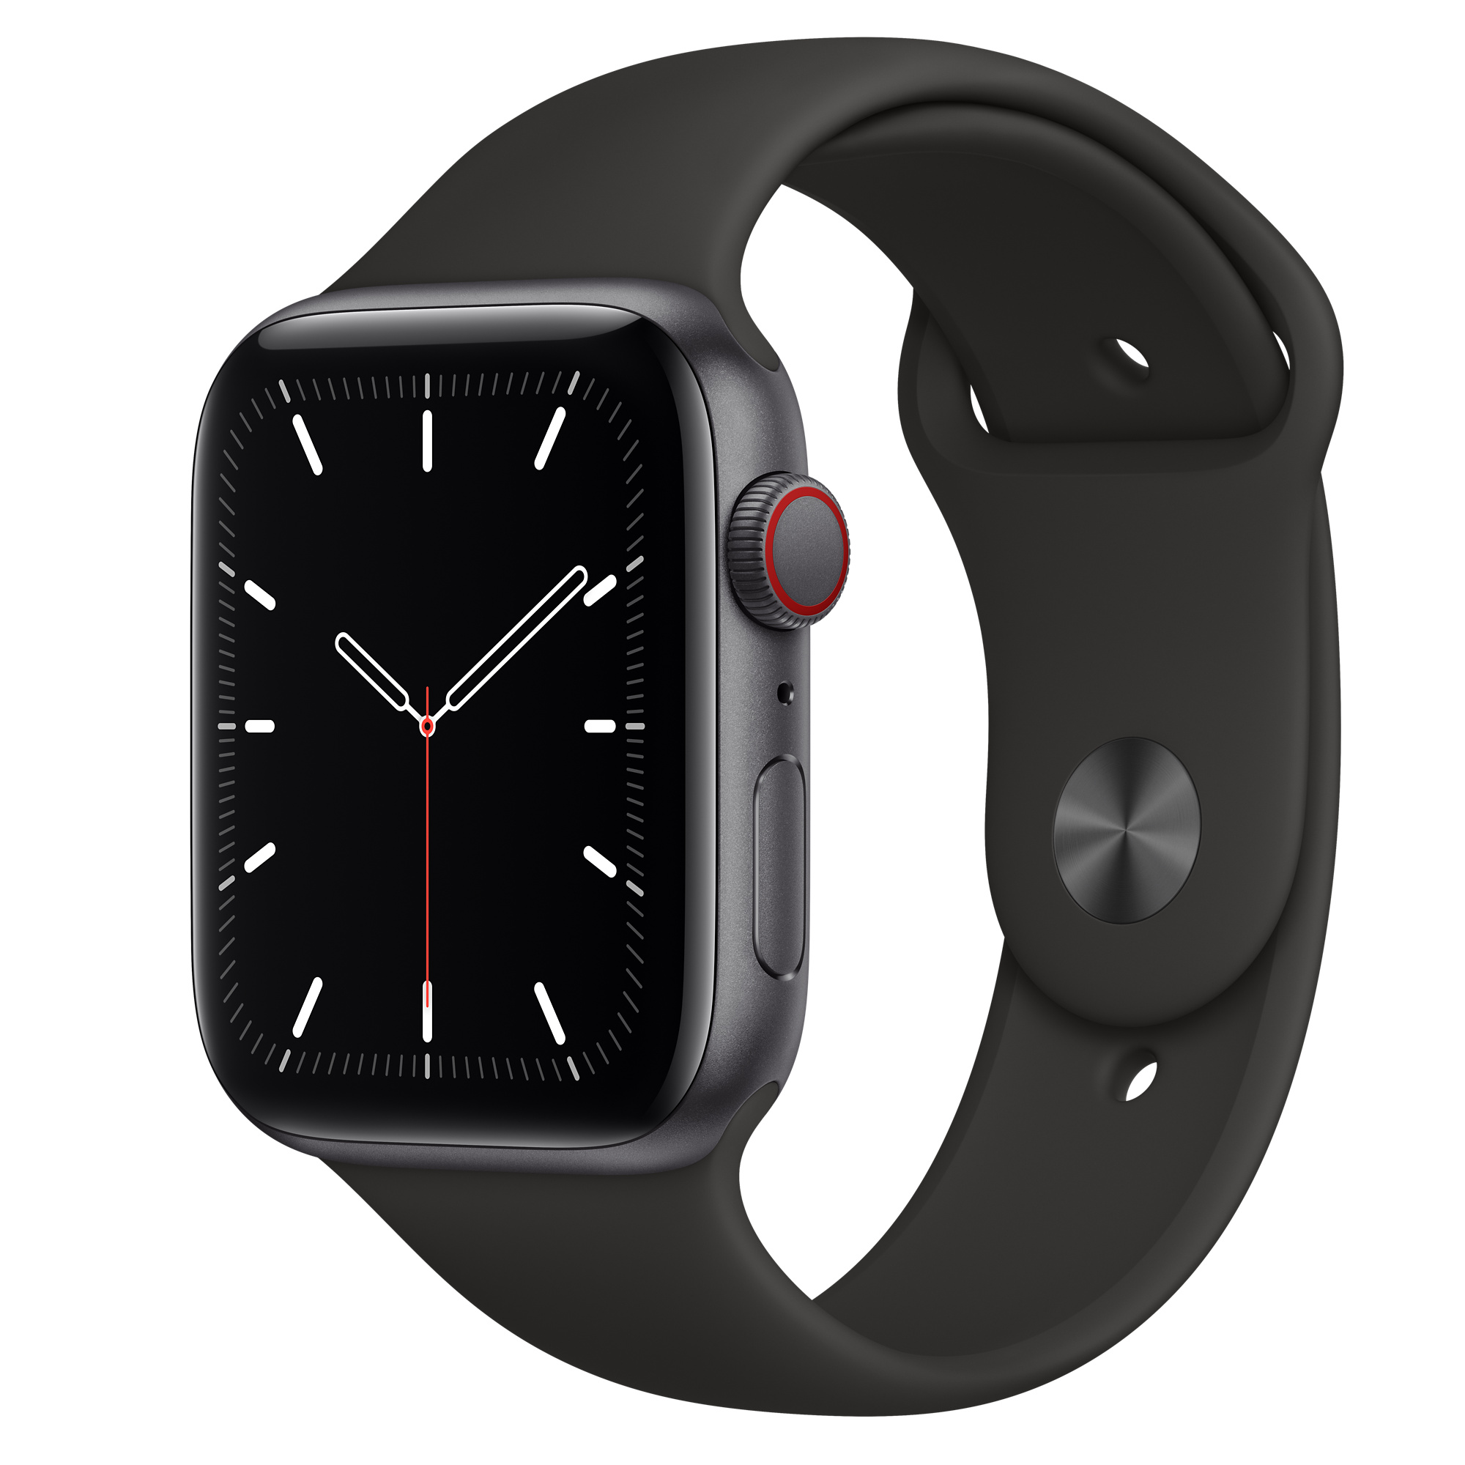
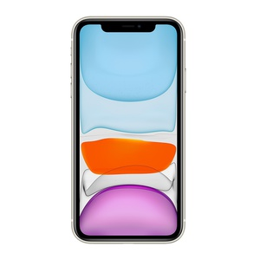
System Overview
Sensor Data
Smartphone
Galaxy 10
GPS, accelerometer, barometer, compass, gyroscope, proximity sensor, step counter, geomagnetic field sensor, ambient and device temperature sensor
Smartwatch
Galaxy watch 4
Physical: heart rate, ECG, thermometer, pulse oximeter
External: accelerometer, barometer, compass, gyroscope, ambient light, GPS
Provide feedback: through earphones or vibration
Gather physical data using smart watch sensors
Use locational query data and smartwatch data to calculate optimal pace with ML
Optional: use data/ML to detect good running posture

Slide 7
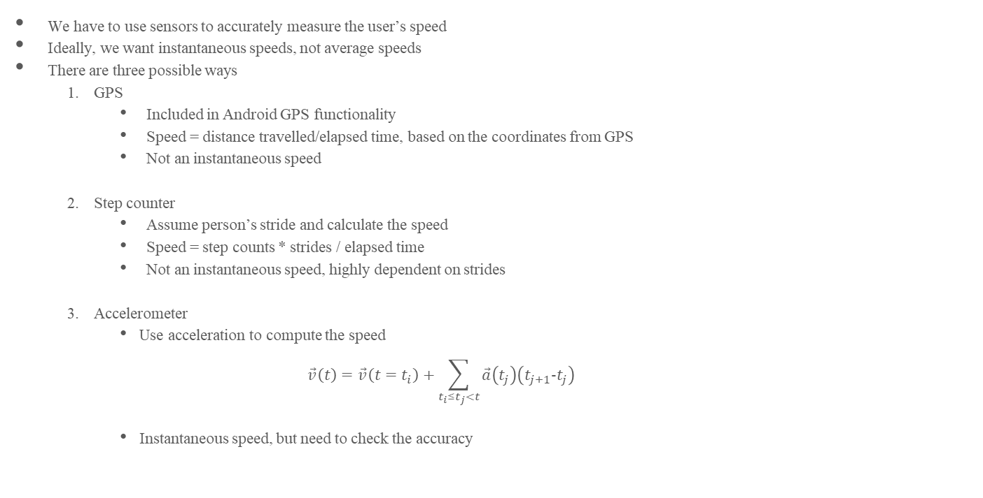
Specifications
We have to use sensors to accurately measure the user’s speed
Ideally, we want instantaneous speeds, not average speeds
There are three possible ways
GPS
Included in Android GPS functionality
Speed = distance travelled/elapsed time, based on the coordinates from GPS
Not an instantaneous speed
Step counter
Assume person’s stride and calculate the speed
Speed = step counts * strides / elapsed time
Not an instantaneous speed, highly dependent on strides
Accelerometer
Use acceleration to compute the speed
$$\vec{v}\left(t\right)=\vec{v}\left(t=t_{i}\right)+\sum_{t_{i}≤t_{j}<t}{\vec{a}\left(t_{j}\right)\left(t_{j+1}-t_{j}\right)}$$
Instantaneous speed, but need to check the accuracy

Slide 8
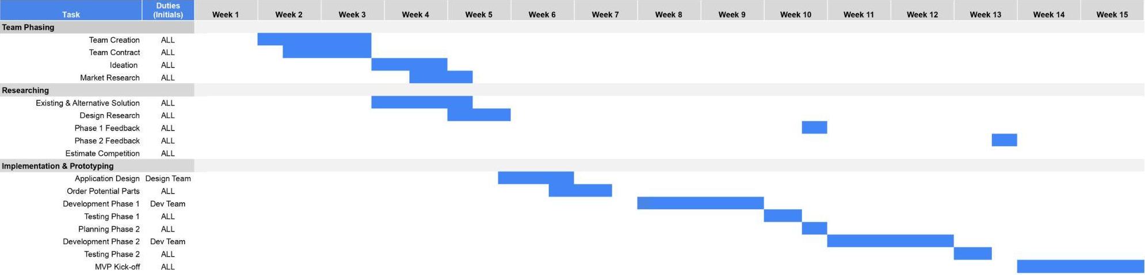
Planning

